Slide 1
Contents
Data
Characteristics of data
Types of digital data
Sources of data
Working with unstructured data
Evolution and Definition of big data
Characteristics and Need of big data
Challenges of big data

Slide 2
Data
Data are raw facts and figures that on their own have no meaning
These can be any alphanumeric characters i.e. text, numbers, symbols
Data Examples
Yes, Yes, No, Yes, No, Yes, No, Yes
42, 63, 96, 74, 56, 86
51017
None of the above data sets have any meaning until they are given a CONTEXT and PROCESSED into a useable form

Slide 3
Data Into Information
To achieve its aims the organisation will need to process data into information.
Data needs to be turned into meaningful information and presented in its most useful format
Data must be processed in a context in order to give it meaning
Information
Data that has been processed within a context to give it meaning
Examples:
5/10/07 The date of your final exam.
51,007 The average starting salary of an employee.
51007 Zip code of Bronson Iowa.

Slide 4
Knowledge (insights)
Knowledge is the understanding of rules needed to interpret information
“…the capability of understanding the relationship between pieces of information and what to actually do with the information”
-Debbie Jones
Examples:
With that information DEO can allot rooms for exams
Faculty can prepare question papers

Slide 5
Characteristics of data
Completeness
Validity
Accuracy
Consistency
Availability
Timeliness

Slide 6



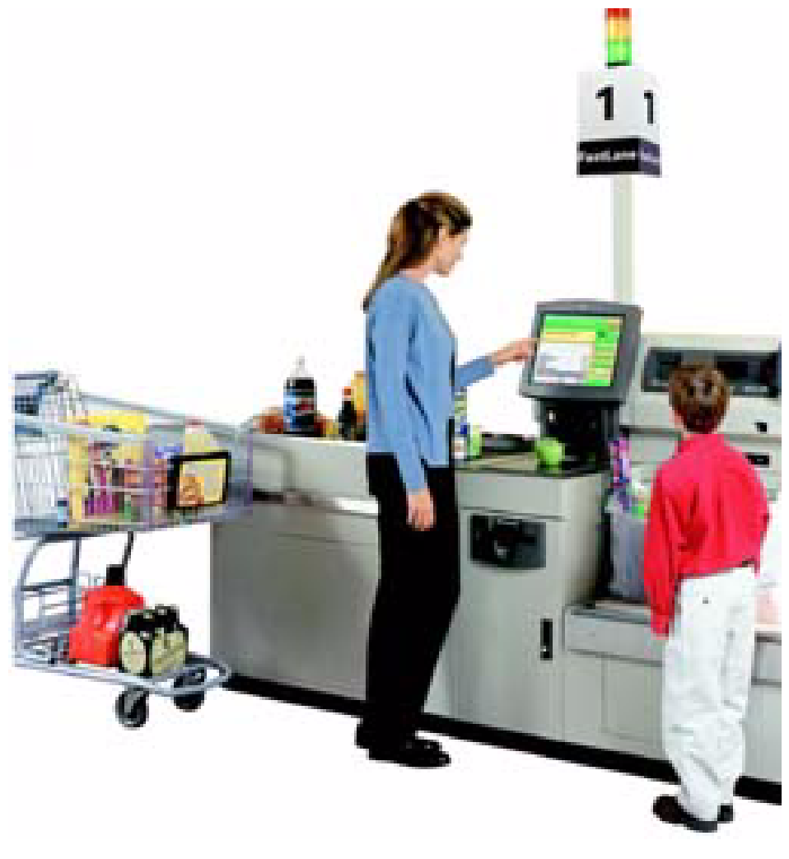
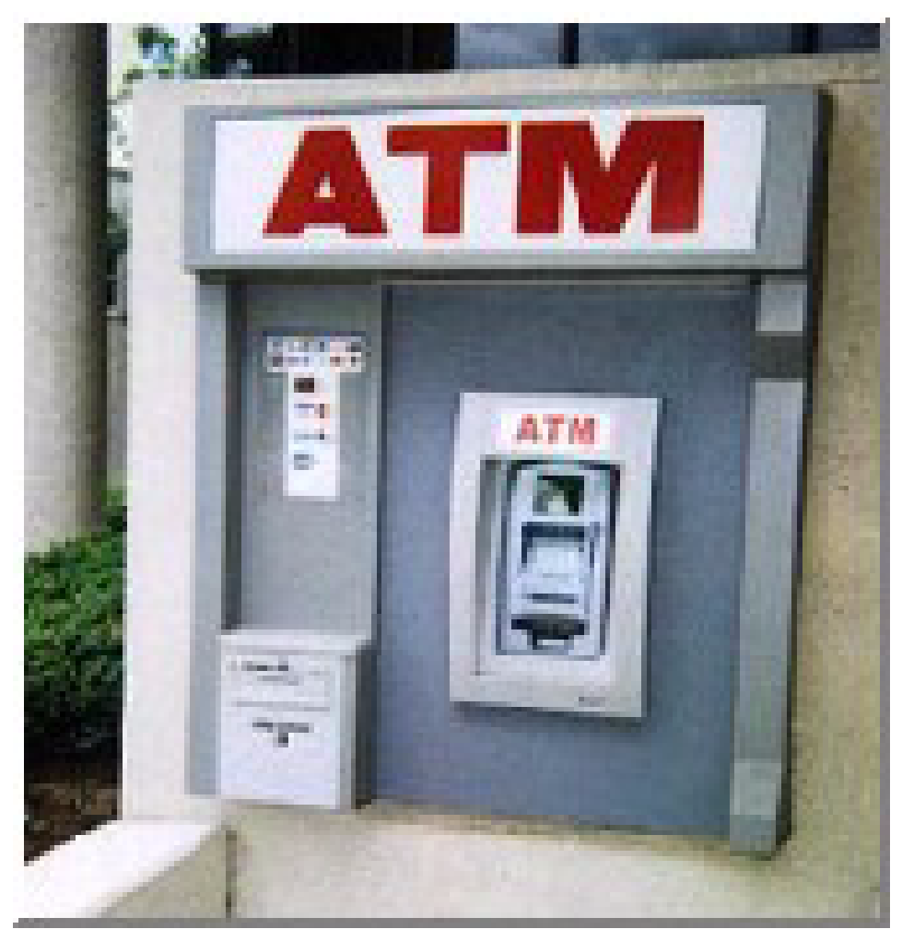
Data Every Where!
Lots of data is being collected and warehoused
Web data, e-commerce
purchases at department/ grocery stores
Bank/Credit Card transactions
Social Network

Slide 7
How much data?
Every Day
NYSE(New York Stock Exchange) generates 1.5 billion shares and trade data
Face book stores 2.7 billion comments and Likes
Google processes about 24 peta bytes of data
Every Minute
Face book users shares nearly 2.5 million pieces of content
Twitter users tweet nearly 300,000times
Instagram users post nearly 220,000 new photos
Youtube users upload 72 hours of new video content
Apple users download nearly 50,000 apps
Email users send over 200 million messages
Amazon generates over $80,000 in online sales
Google receives over 4million search queries
Every second
Banking applications process more than 10,000 credit card transactions

Slide 8
Data: the treasure trove
Provides business advantages such as
Generating product recommendations
Inventing new products
Analyzing the market
Provides few early key indicators that can turn the fortune of business
Provides room for precise analysis. If we have more data for analysis then we have greater precision of analysis

Slide 9
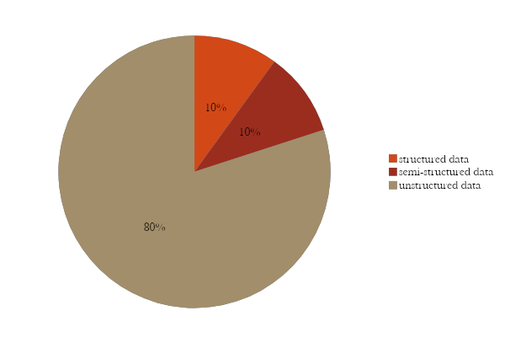
Classification of Digital Data
Structured data
Semi structured data
Unstructured data

Slide 10
Structured Data
Organized form (rows and columns), easily used by computer programs
Relationships exist between entities of data such as classes and objects
Ex: Data stored in databases
Sources of structured data
Databases such as Oracle,DB2,Teradata,MySQL,PostgreSQL
Spreadsheets
OLTP systems

Slide 11
Ease of working with structured data
Input/update/delete
Security
Ease with structured data
Indexing/Searching
Scalability
Transaction Processing

Slide 12
Semi structured data
Not confirm to the data model and Uses tags
Inconsistent Structure
Self-describing (label/value pairs)
Semi-structured Data
Often schema information is blended with data values
Data object may have different attributes not known beforehand
Characteristics of semi-structured data

Slide 13
Sources of semi structured data
XML
Other markup languages
JSON(Java Script Object Notation)

Slide 14
Unstructured data
Social Media Data
Sources of unstructured data
Web pages
Images
Unstructured data
Freeform text
Audios
Text messages/ chats
Body of email

Slide 15
Working with unstructured data
Data Mining
Natural Language Processing(NLP)
Dealing with unstructured data
Text Analysis
Noisy Text Analysis

Slide 16
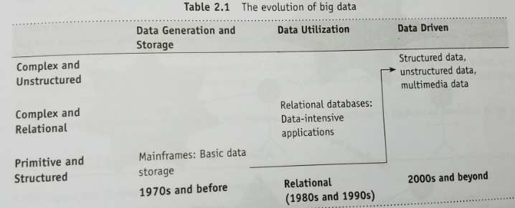
Evolution and Definition of big data

Slide 17
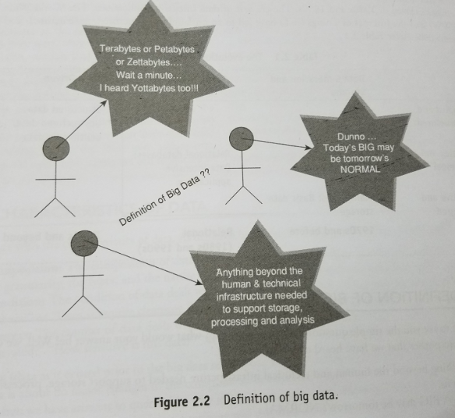
Tera bytes or petabyttes
Anything beyond the human & technical infrasture needed to support storage, processing and anlysis.
Today’s a BIG may be tomorrow’s NORMAL

Slide 18
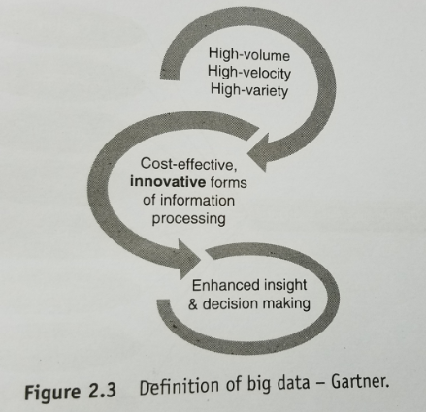
Definition of Big Data
High Volume , High velocity , High variety of data is processed by cost-effective innovative forms of information processing to get enhanced insight and decision making.

Slide 19
Characteristics of big data
Big data is data that big in
Volume
Velocity
Variety
Veracity
Validity
Volatility
Variability

Slide 20
Big Data characteristics
Volume : From bits to bytes, peta bytes and exa bytes.
Velocity: Batch -> periodic ->Near Real Time -> Real-Time Processing.
Variety: Variety deals with a wide range of data types and sources of data.

Slide 21
Characteristics of data
Veracity: Veracity refers to biases, noise and abnormality in data.
Validity: Validity refers to the accuracy and correctness of the data.
Volatility: Volatility deals with how long data is valid?
Variability: Data flows can be highly inconsistent with periodic peaks.

Slide 22
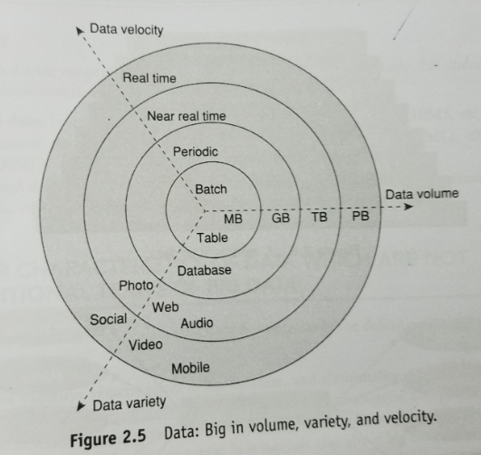

Slide 23
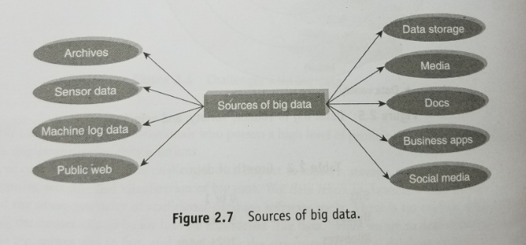

Slide 24
Need of big data
More data 🡪 More accurate analysis 🡪 Greater confidence in decision making🡪 Greater official efficiency, cost reduction, time reduction, new product development, and optimized offerings, etc

Slide 25
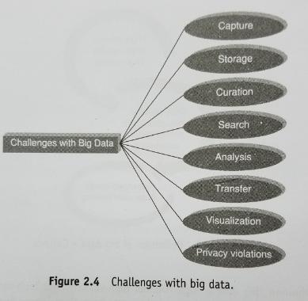
Challenges of big data

Slide 26
UNIT-1
BIG DATA ANALYTICS

Slide 27
Contents
Overview of business intelligence
Data science and Analytics
Meaning and Characteristics of big data analytics
Need of big data analytics
Classification of analytics
Challenges to big data analytics
Importance of big data analytics
Basic terminologies in big data environment

Slide 28
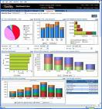
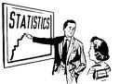

What is Business Intelligence?
Business Intelligence enables the business to make intelligent, fact-based decisions
Aggregate Data
Present
Data
Enrich
Data
Inform a Decision
Add Context to Create Information, Descriptive Statistics, Benchmarks, Variance to Plan
Database, Data Mart, Data Warehouse, ETL Tools, Integration Tools
Reporting Tools, Dashboards, Static Reports, Mobile Reporting, OLAP Cubes
Decisions are Fact-based and Data-driven

Slide 29
Business Intelligence (BI) Tools
Data Sources
Data Warehousing
OLAP (Online Analytical Processing)
Data Mining
Regression
Predicting Customer Behavior
cloud technology
mobile BI
visual analytics.
Market Basket Analytics
Text Analytics
Customer Segmentation/Clustering

Slide 30

Amazon.com and NetFlix
Collaborative Filtering tries to predict other items a customer may want to purchase based on what’s in their shopping cart and the purchasing behaviors of other customers

Slide 31
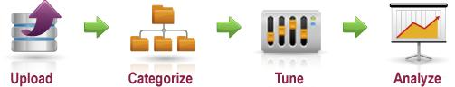

Unstructured Text Processing
Facebook Page
Twitter
Page
Customer Sat Survey Comments
Call
Center
Notes,
Voice
Services
Quality
Cost
Friendliness
Competitors’ Facebook
Pages
Public Web Sites,
Discussion Boards, Product Reviews
Email
Blogs
Alerts,
Real-time Action
Adhoc Feedback

Slide 32
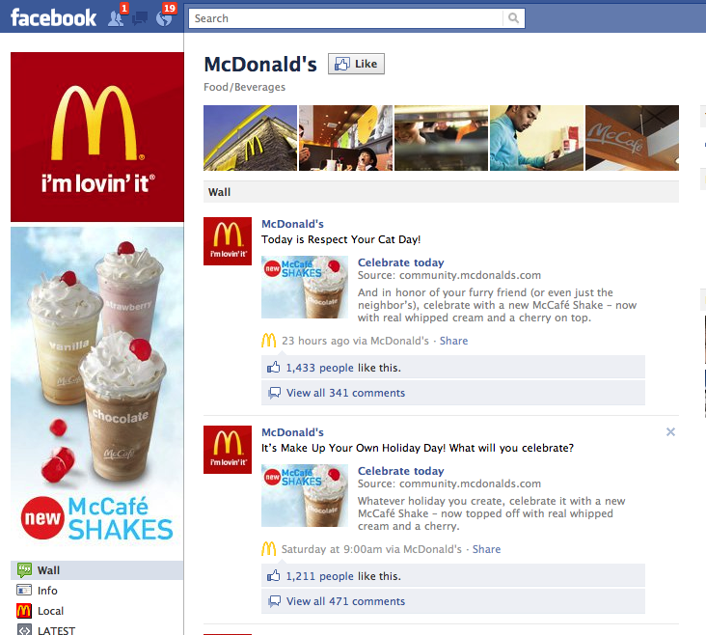

Slide 33
Data Science
Data science is the science of extracting knowledge from data
(Or)
It is a science of drawing out hidden patterns amongst data using statistical techniques and information technology (machine learning, data engineering, probability models and pattern recognition)
Business Acumen
Technology Expertise
Data science
Mathematics expertise

Slide 34
Data Science use cases
Exploring Massive Datasets
Weather predictions
Oil drillings
Seismic activities
Financial frauds
Terrorist network and activities
Global economic impacts
Sensor logs
Social media analytics

Slide 35
Data Science use cases
Manufacturing
Customer churn
Market basket analytics(associative mining)
Collaborative filtering
Regression analysis

Slide 36
Business Acumen Skills
Understanding of domain
Business strategy
Problem solving
Communication
Presentation

Slide 37
Technology expertise
Good database knowledge such as RDBMS
Good NoSQL database knowledge such as MongoDB, Cassandra, Hbase etc
Programming languages such as java, python, C++ etc.
Open source tools such as Hadoop
Data warehousing
Data mining
Visualization such as Tableau, Flare, Google visualization APIs etc

Slide 38
Mathematics expertise
Mathematics
Statistics
Artificial Intelligence
Algorithms
Machine learning
Pattern recognition
Natural language processing

Slide 39
Data Science process is
Collecting raw data from multiple disparate data sources
Processing the data
Integrating the data and preparing clean datasets
Engaging in explorative data analysis using model and algorithms
Preparing presentations using data visualization
Communicating the findings to all stakeholders
Making faster and better decisions

Slide 40
Responsibilities of a data scientist
Data Management:
Raw---> relationships--->preprocessing and further analysis
Analytical Techniques
Employs a blend of analytical techniques to Develop models
Algorithms to understand data, interpret relationships and spot trends
Business analysts
Able to apply domain knowledge to see results
Good presenter
communicator

Slide 41
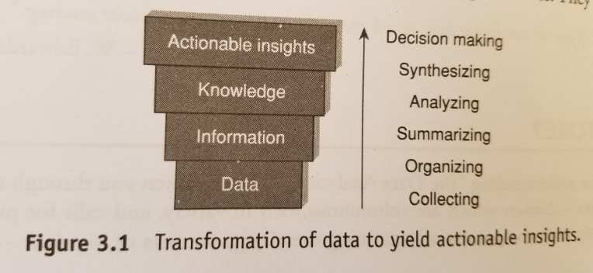
Meaning and Characteristics of BDA

Slide 42
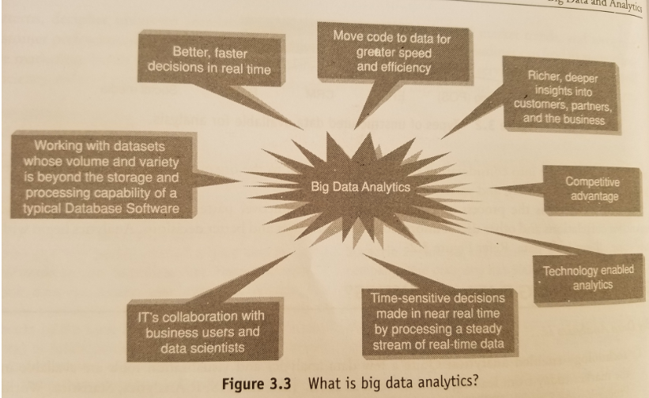

Slide 43
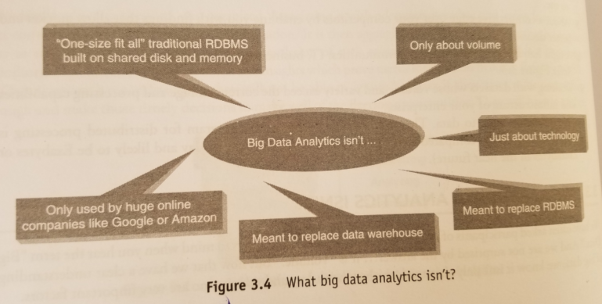

Slide 44
Need of Big Data Analytics
Reactive – Business Intelligence
Reactive-Big Data Analytics
Proactive- Analytics
Proactive-Big Data Analytics

Slide 45
Reactive – Business Intelligence
Business intelligence helps to make faster and better decisions by providing the right information to the right persons at right time in right format.
Analysis of historical data and displaying findings of analysis in the form of enterprise dashboards, alerts and notifications

Slide 46
Reactive-Big Data Analytics
Analysis on huge datasets but the approach is still reactive because of static data.

Slide 47
Proactive- Analytics
Futuristic decision making by dm, predictive modeling, text mining and statistical analysis
Traditional database management used on big data therefore several limitations on storage capacity and processing.

Slide 48
Proactive-Big Data Analytics
Filter out relevant data ( Terabytes, petabytes, exabytes of information) for analysis.
High performance analytics used to gain rapid insights from big data and the ability to solve complex problems using more data.

Slide 49
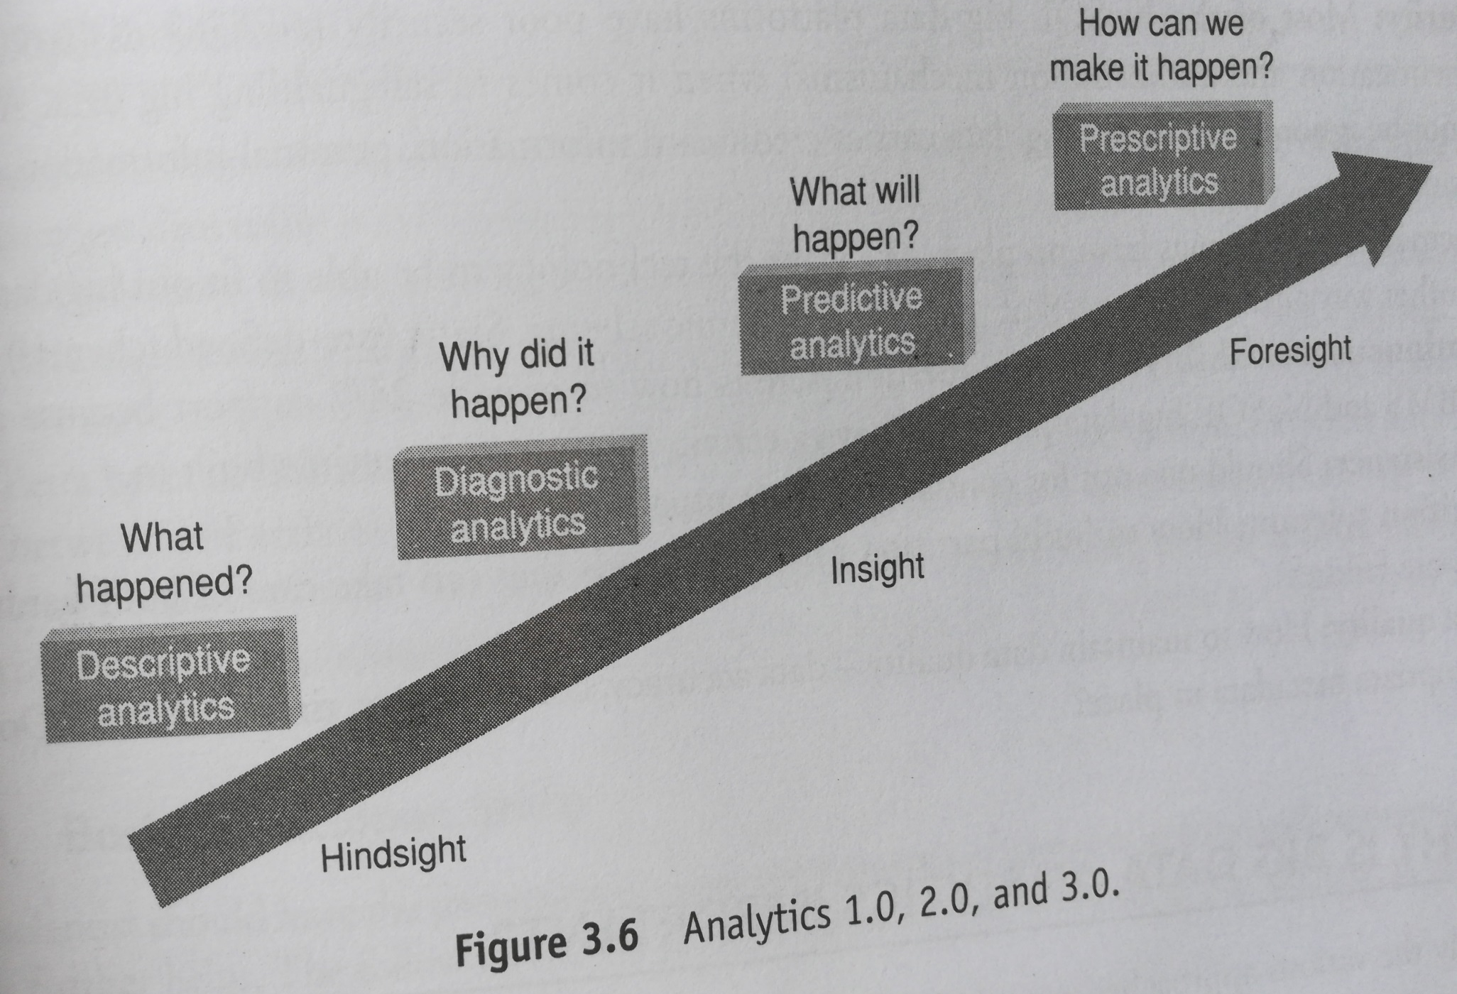
Classification of analytics

Slide 50
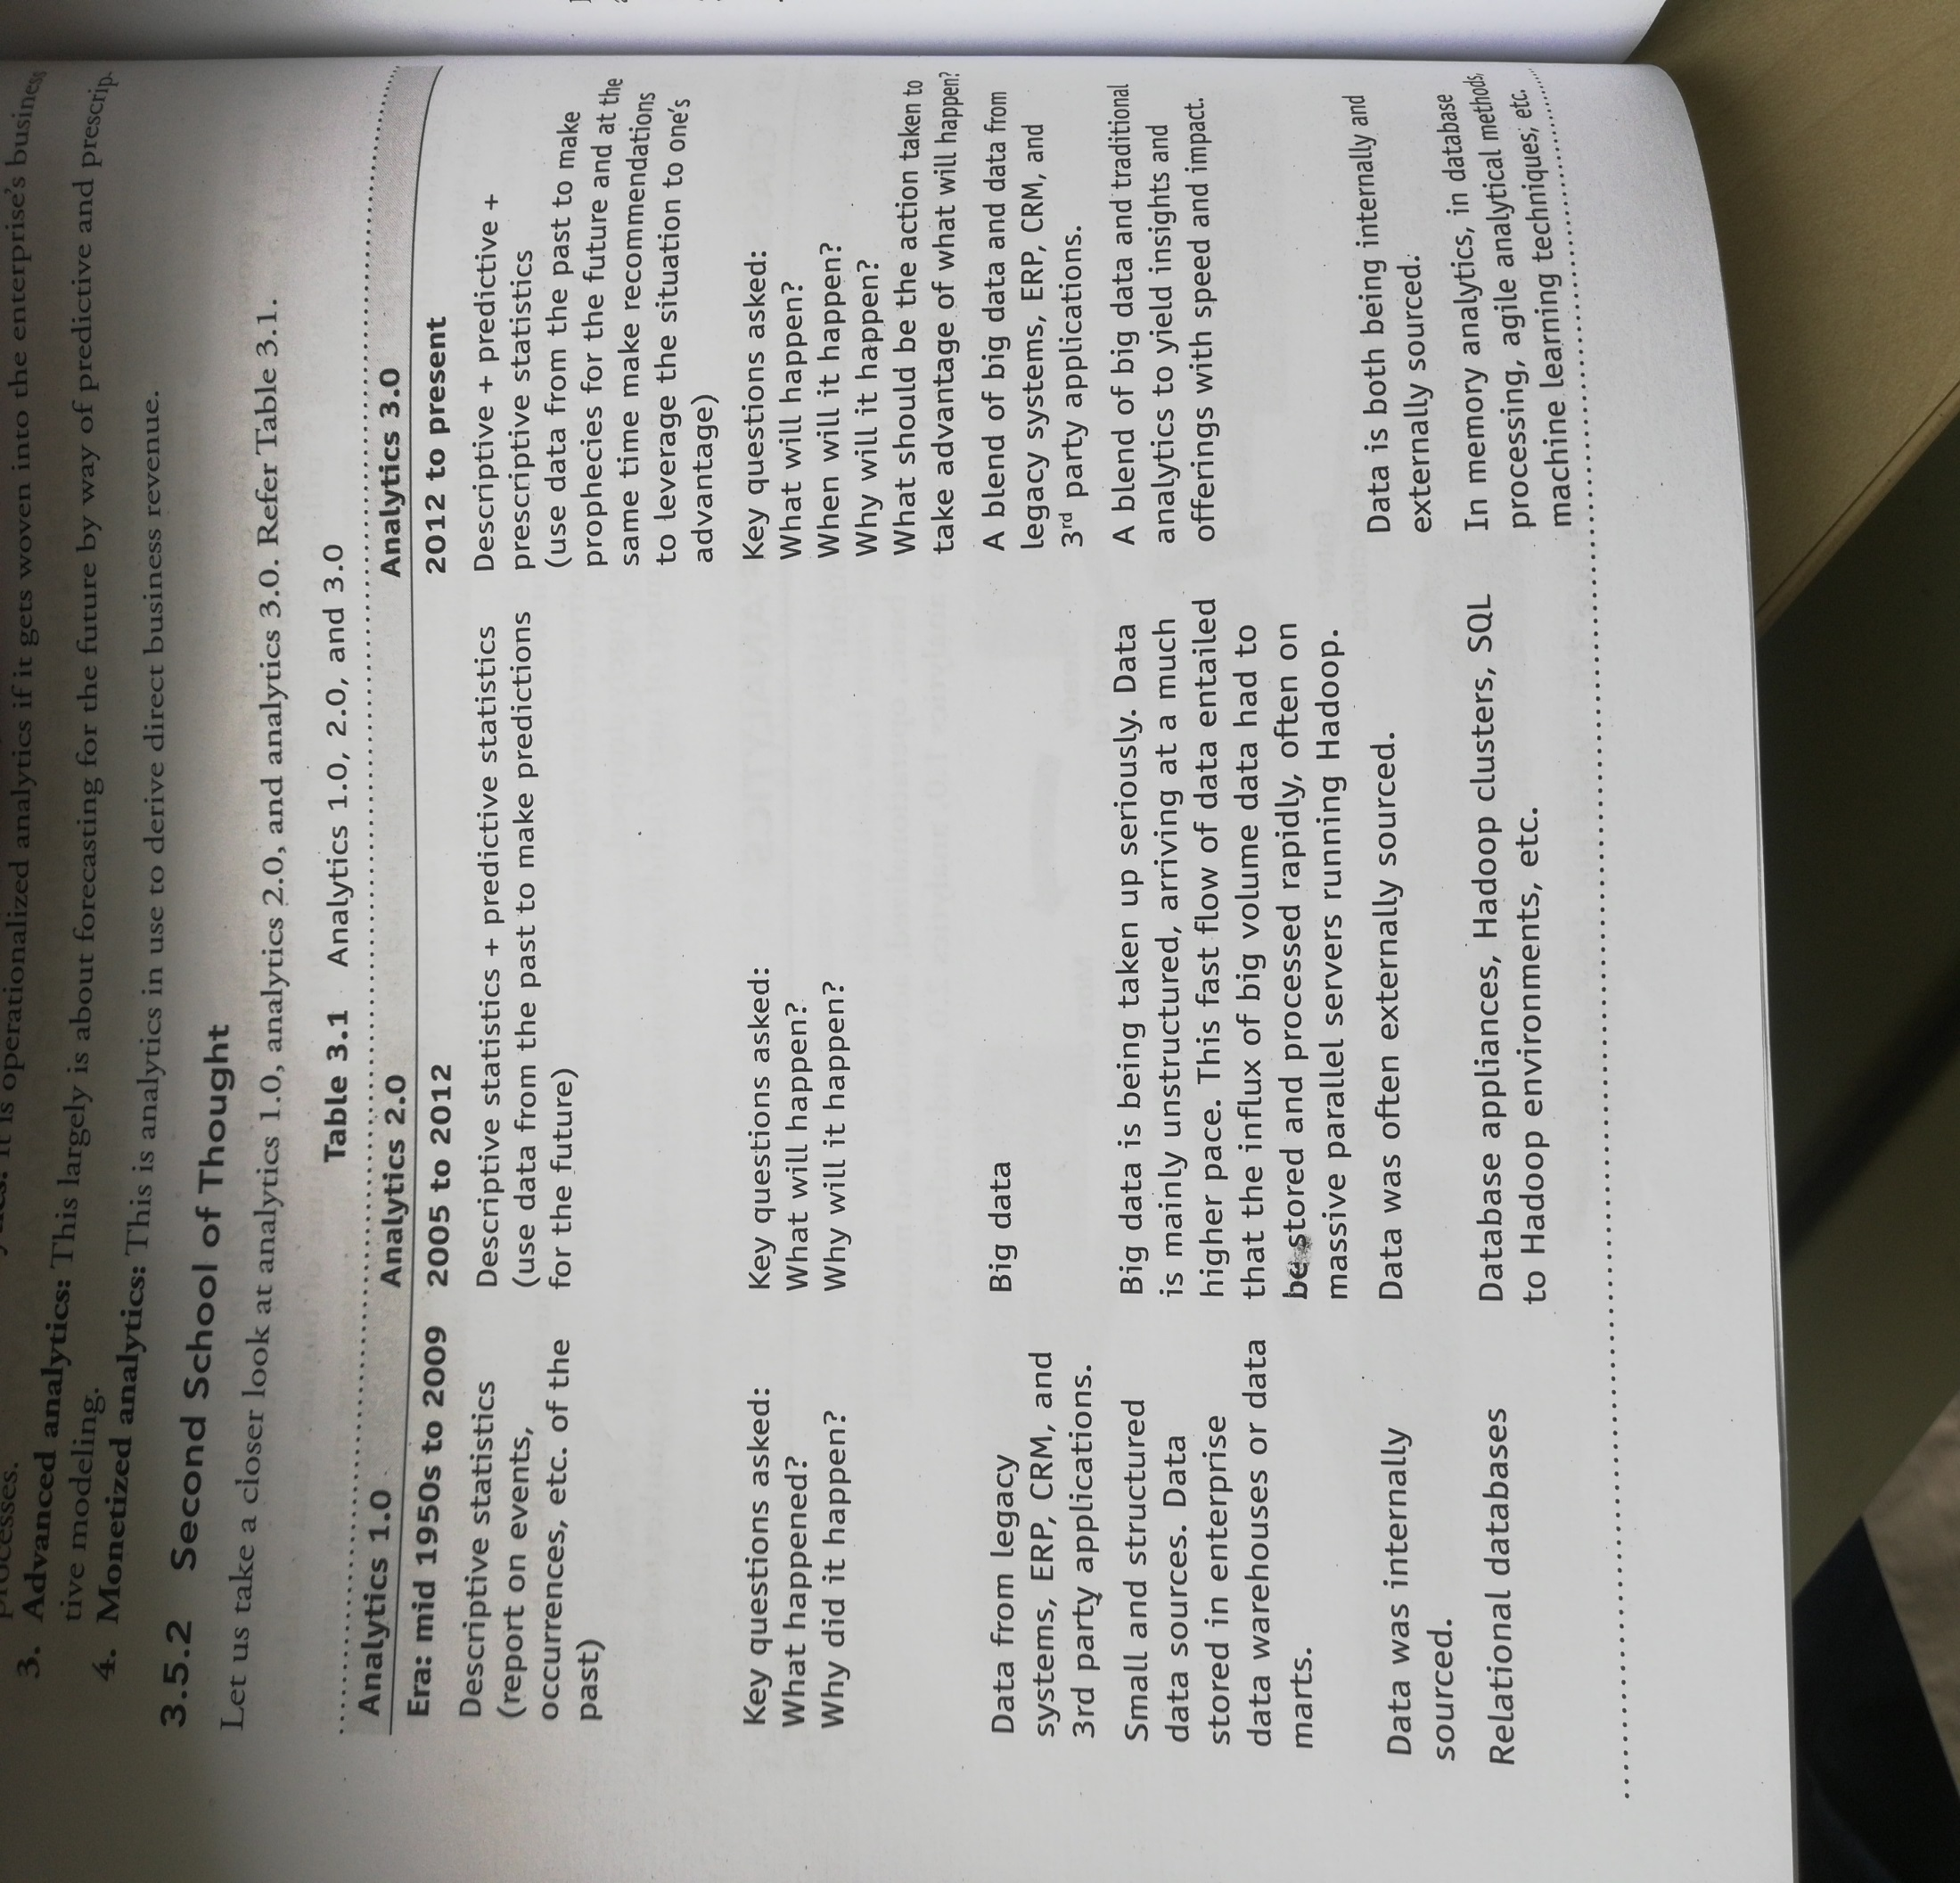
Classification of analytics

Slide 51
Challenges of Big Data Analytics
Storage:
RDBMS can store only structured data
(rows and columns)
Ex: Employee details in a company
Big data(3V’s) is mixed up with different structures.
(Should we scale vertically or horizontally?)
Ex: Web logins, XML documents and all the data coming from sensors
E.ID | E.name | E.Salary

Slide 52
Contd..,
Security
RDMS(Normal Data)
Authentication-user connects to RDMS
Authorization-perform certain actions
Data Encryption
virus control

Slide 53
Contd..,
NoSQL(Big Data)
Column: cassandra,Hbase
Document: clusterpoint,apache couchDB
Graph: OrientDB,Apache Giraph
lack of proper authentication and security mechanisms
Ex:credit card information, personal information

Slide 54
Contd..,
Schema
Static schema(fixed attributes)
Ex:Student database(1000x15)
Dynamic Schema
Ex:Online application filling

Slide 55
Contd..,
Continuous availability
RDBMS and NoSQL big data platforms have certain amount of downtime built in

Slide 56
Contd..,
Partition tolerant:
How to build partition tolerant systems to handle both h/w and s/w failures

Slide 57
Contd..,
Data Quality:
How to maintain data quality
Data accuracy
Completeness
Timeliness
Do we have appropriate meta data in place?

Slide 58
Terminologies used in Big Data Environment
In-memory analytics
Data access from non-volatile storage such as hard disk is a slow process.
Pre-process and store data(cubes, aggregate tables)
Advance Thinking
Addressed using in memory analytics-all relevant data is stored in RAM
Advantages-faster access, rapid deployment, better insights and minimal IT involvement
Apache Spark .

Slide 59
Contd..,
In-database processing(In-database analytics)
Fusing data warehouses with analytical systems(the database itself can run the computations eliminating the need for export)
Today, many large databases, such as those used for credit card fraud detection and investment bank risk management, use this technology because it provides significant performance improvements over traditional methods
Teradata , IBM, IEMC() Greenplum, Sybase, ParAccel, SAS, and EXASOL

Slide 60
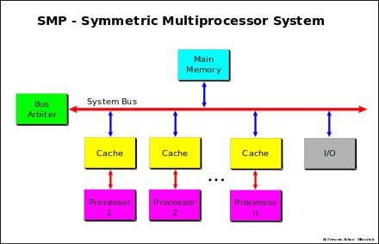
SMP : Symmetric MultiProcessor System

Slide 61
SMP
There is a single common main memory that is shared by two or more identical processors.
The processors have full access to all I/O devices
Controlled by single Operating System.
SMP are tightly coupled multiprocessor systems.
Each processor has its own high-speed memory called cache memory and connected using a system bus

Slide 62
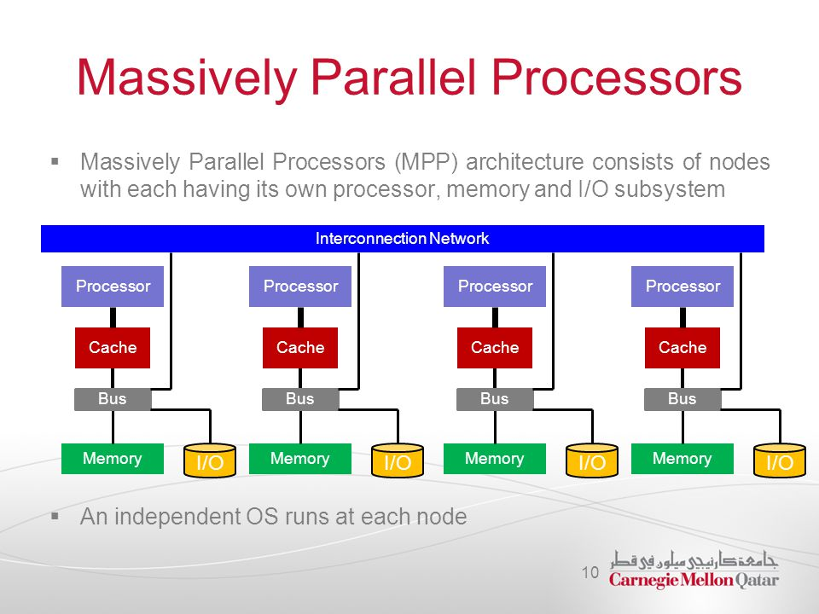
Massively parallel processing

Slide 63
MPP: Massively Parallel Processing
MPP refers to the coordinated processing of programs by a number of processors working parallel.
They work on different parts of the same program.
MPP processors communicate using some sort of messaging interface
They are more difficult to program as the application must be divided in such a way that all the executing segments can communicate with each other.

Slide 64
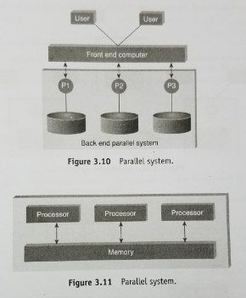
Difference between Parallel and Distributed System

Slide 65
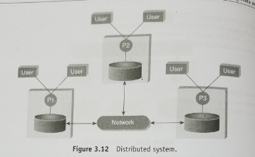

Slide 66
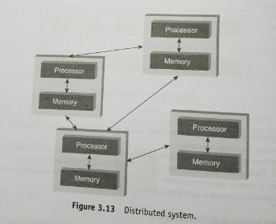

Slide 67
Contd..,
Shared Nothing Architecture
Shared memory-common memory shared by multiple processors.
Shared disk- multiple processors share a common collection of disks while having their own private memory.
Shared nothing-neither memory nor disk is shared among multiple processors.
Advantages of Shared Nothing Architecture
Fault isolation-should not effect the process if any node is failed
Scalability-reduces the burden on disk storage, increases the processing speed

Slide 68
Contd..,
CAP Theorem(Brewer’s theorem)
It states that in a distributed computing environment impossible to provide the following guarantees
Consistency(every read fetches the last write)
Availability(each non failing node will return a response in a reasonable amount of time)
Partition tolerance(system will continue to function when network partition occurs)

Slide 69
Contd..,
Brewer’s CAP
Consistency
CAP
Availability
Partition Tolerance

Slide 70
Contd..,
Examples of databases that follow one of the possible three combinations:
Availability and partition tolerance(AP)
Consistence and partition tolerance(CP)
Consistence and Availability(CA)

Slide 71
